Slide 1



TNSDC - GENERATIVE AI FOR ENGINEERING
FINAL PROJECT
Submitted by
Abishek S
(311521104003)

Slide 2

PROJECT TITLE
MULTILINGUAL TEXT TRASLATOR

Slide 3
01.
PROBLEM STATEMENT
02.
PROJECT OVERVIEW
03.
END USERS
TABLE OF
CONTENT
04.
VALUE PROPOSITION
05.
SOLUTION
06.
MODELLING
07.
RESULTS

Slide 4
PROBLEM STATEMENT
Develop a Python program using generative AI and the Transformers library to facilitate text translation between different languages. The program should prompt the user to input the source and target languages, as well as the text to be translated. It should then utilize pre-trained models to generate accurate translations and display the results to the user. Exception handling should be implemented to ensure smooth execution even in case of errors.

Slide 5
PROJECT OVERVIEW
This project revolves around building a user-friendly text translation program using cutting-edge generative AI and the Transformers library. By inputting source and target languages along with the text, users can obtain accurate translations with ease. We'll showcase the broad spectrum of languages supported by the pre-trained models, catering to diverse linguistic needs. . Our goal is to emphasize the significance of language translation while inviting audience participation and future exploration.

Slide 6
END USERS
Travelers and Tourists: Individuals traveling to foreign countries for leisure or business purposes who need to translate signs, menus, directions, and other text-based information in real-time.
Language Learners: Students and enthusiasts learning a new language who require assistance in translating texts to aid their comprehension and language acquisition process.
Multinational Corporations: Businesses operating globally that need to translate documents, emails, reports, and other communication materials to facilitate collaboration and communication among their international teams and clients.
Researchers and Academics: Professionals in the field of linguistics, anthropology, sociology, and related disciplines who utilize translation services to analyze and study texts from different languages and cultures.

Slide 7
SOLUTION
The solution provided by the text translation program addresses the problem statement by offering a user-friendly platform for translating text between different languages. Leveraging generative AI and the Transformers library, the program accurately translates input text from a source language to a target language. Users can easily interact with the program by specifying the source and target languages along with the text to be translated. The program utilizes pre-trained models to generate precise translations, ensuring effective communication across linguistic boundaries. With its intuitive interface and wide language coverage, the solution streamlines the translation process, saving time and resources while facilitating seamless cross-cultural communication.

Slide 8
VALUE PROPOSITION
The value proposition of the text translation program lies in its ability to provide accurate and efficient language translation services, enabling seamless communication across linguistic barriers. By leveraging generative AI and the Transformers library, the program ensures precise translations, maintaining the integrity of the original message. Users benefit from a user-friendly interface that simplifies the translation process, saving time and effort. With support for a wide range of languages, the program caters to diverse linguistic needs, making it indispensable for individuals, businesses, and organizations operating in a globalized world. Overall, the program offers enhanced accessibility, efficiency, and effectiveness in cross-cultural communication, empowering users to connect and collaborate effectively regardless of language differences.

Slide 9
The "wow" factor in the solution is its seamless integration of cutting-edge generative AI and the Transformers library to deliver remarkably accurate translations. This advanced technology empowers users to effortlessly bridge language barriers with precision and efficiency. Additionally, the program's intuitive interface and wide language coverage ensure accessibility and usability for a diverse range of users. Whether it's translating complex business documents or navigating foreign environments during travel, the program offers a transformative solution that simplifies and enhances cross-cultural communication. Its ability to facilitate smooth, accurate, and quick translations truly sets it apart, eliciting a "wow" response from users encountering its capabilities.

Slide 10
MODELLING
The model used in the code is the MarianMTModel from the Transformers library. Specifically, it employs the pre-trained models available under the "Helsinki-NLP/opus-mt-{source_language}-{target_language}" format. These models are trained for machine translation tasks, allowing the program to translate text from a source language to a target language. The MarianMTModel utilizes encoder-decoder architecture and incorporates attention mechanisms for generating accurate translations. It is trained on large multilingual datasets to capture complex language patterns and nuances, enabling high-quality translation outputs.

Slide 11
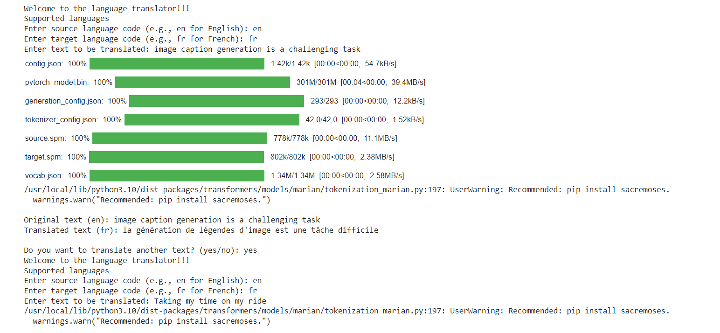
RESULTS

Slide 12
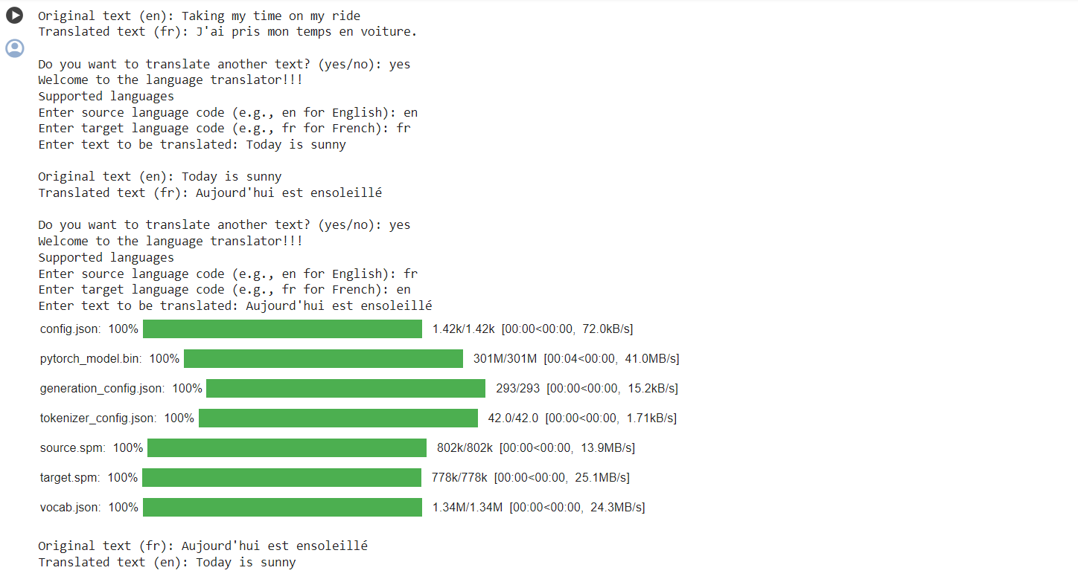

Slide 13
THANK YOU
Project Link
https://github.com/Abishek20104/nmgenai/

